Slide 1
Bunker management for tramp ships with stochastic fuel prices and stochastic waiting times
Gabriel Fuentes
Stein W. Wallace
Roar Ådland

Slide 2
Bunkering statistics
Data driven decision making on commercial ship management
Bunkering management
Voyage pricing

Slide 3
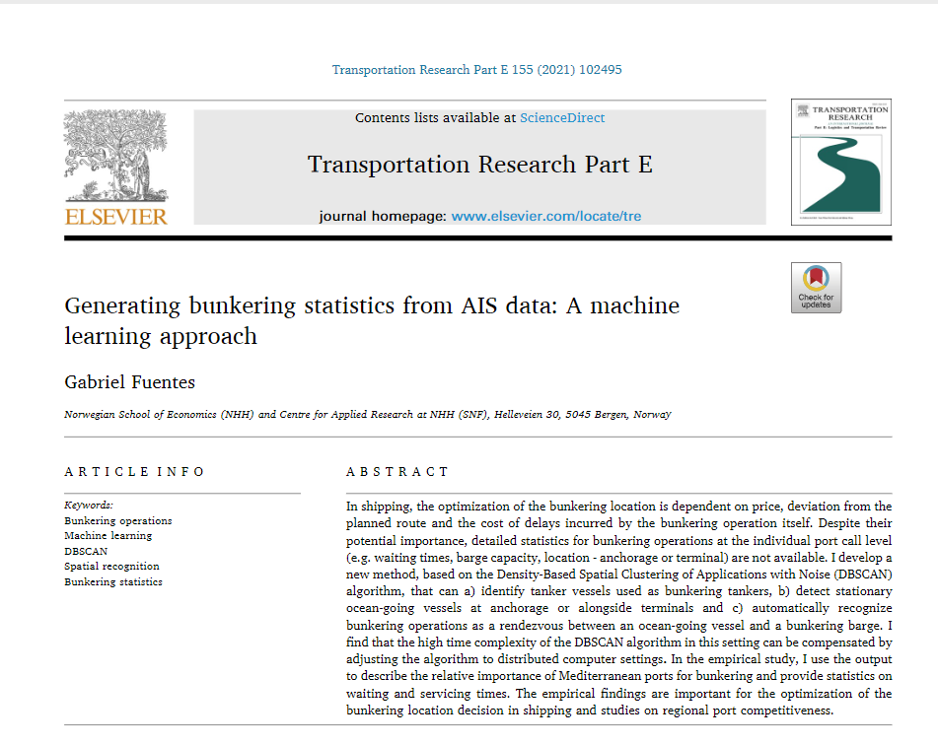
Bunkering statistics

Slide 4
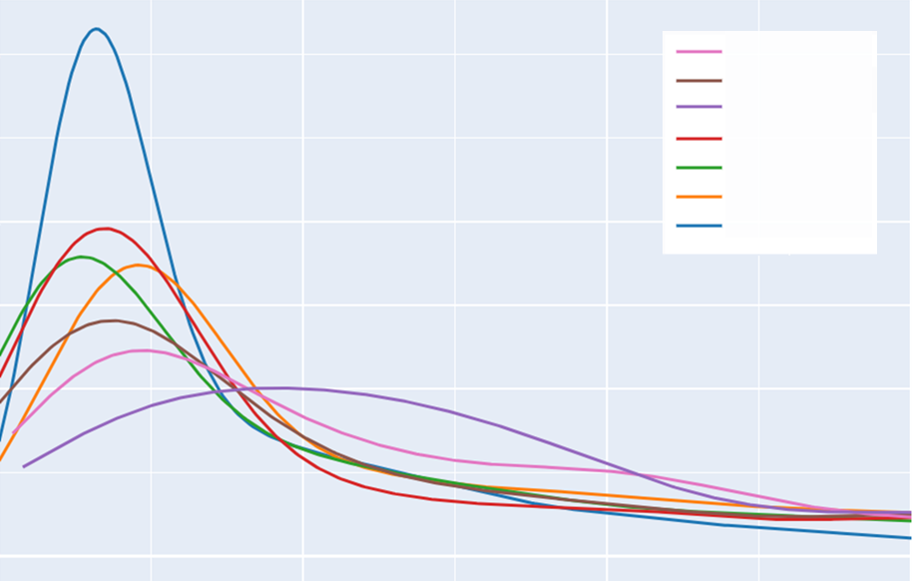
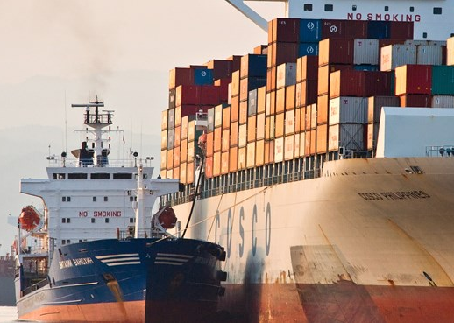
Review
Bunker
.6
Volatile prices mainly driven by crude oil prices
Service time seldom addressed in literature
Not a transparent market
BARCELONA
VALETTA
TANGER
.5
CEUTA
ISTANBUL
ALGECIRAS
.4
GIBRALTAR
.3
.2
.1
Source: Wilhelmsen
Hours
0
0
1
2
3
4
5
6+

Slide 5
Problem description
In the position of a ship owner (voyage charter), must decide where to bunker, speed to take and how much to choose from a tactical strategy (forward contracts) and adjust on spot price realization
The decision is influenced by weather, stochastic waiting time and stochastic spot price
The vessel has some initial fuel and must keep a safe margin at all times within its decision
Bunker consumption is linked to voyage distance, weather routing and voyage speed. Hence, it should be modeled together with the bunkering problem (Meng et al., 2015). This becomes a weather routing + bunkering selection problem = bunkering management problem

Slide 6
Literature
- Operations Research (Inventory Management Problem)
Main division on liner and tramp. Approx. 4x studies in liners than in tramp
Liner shipping with several methods (Stoch. Program., Dyn. Program.,) changes in objective function (e.g emissions), price modeling, etc.
Tramp shipping with adaptations such as instantaneous service is quite common. Main interest on the effect of price stochasticity.
Only one paper (Aydin et al., 2015) consider service time in their model. Though, they introduced uniform distribution cargo operations service time in a liner service and found there is an important impact on the optimal bunkering selection decision.
Closest references Gu et al. (2019); Vilhemsen (2014).

Slide 7
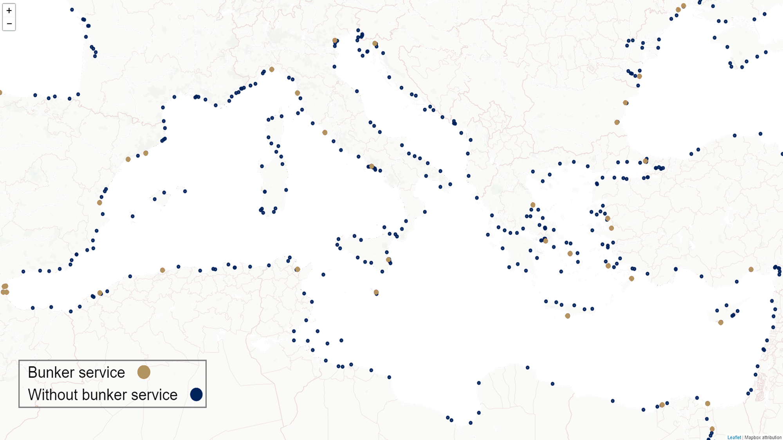

Slide 8
Research question
Is waiting time important in a tramp ship bunkering operation and what is the tradeoff with fuel price?
Stated differently: Ports even with lower prices can lead to more costly decisions based on inneficient service or longer deviations.
How is this question relevant?
Tramp shipping speed decisions are based in a time period (laycan) where the shipowner agreed with the charterer (cargo owner) to arrive to a port and be ready to conduct cargo operation. The shipowner decides the speed of the voyage.
Speed has a close to cubic relation with the fuel consumption
In tight markets it is more relevant to have a proper control of fuel cost

Slide 9
Contribution
Address the literature gaps (Relation of waiting time and price, weather routing, voyage dynamics) by:
Introducing the bunkering waiting time and study its influence to the bunkering decision
Introducing weather and model voyage vessel dynamics to evaluate decisions driven by season
Model a bunkering problem with real waiting times distributions from AIS algorithm
Case study on a bulk carrier with a cargo contract and bunkering decision. Emphasis on the bunkering decisions influenced by freight rate (one ton of cargo vs one ton of fuel)

Slide 10
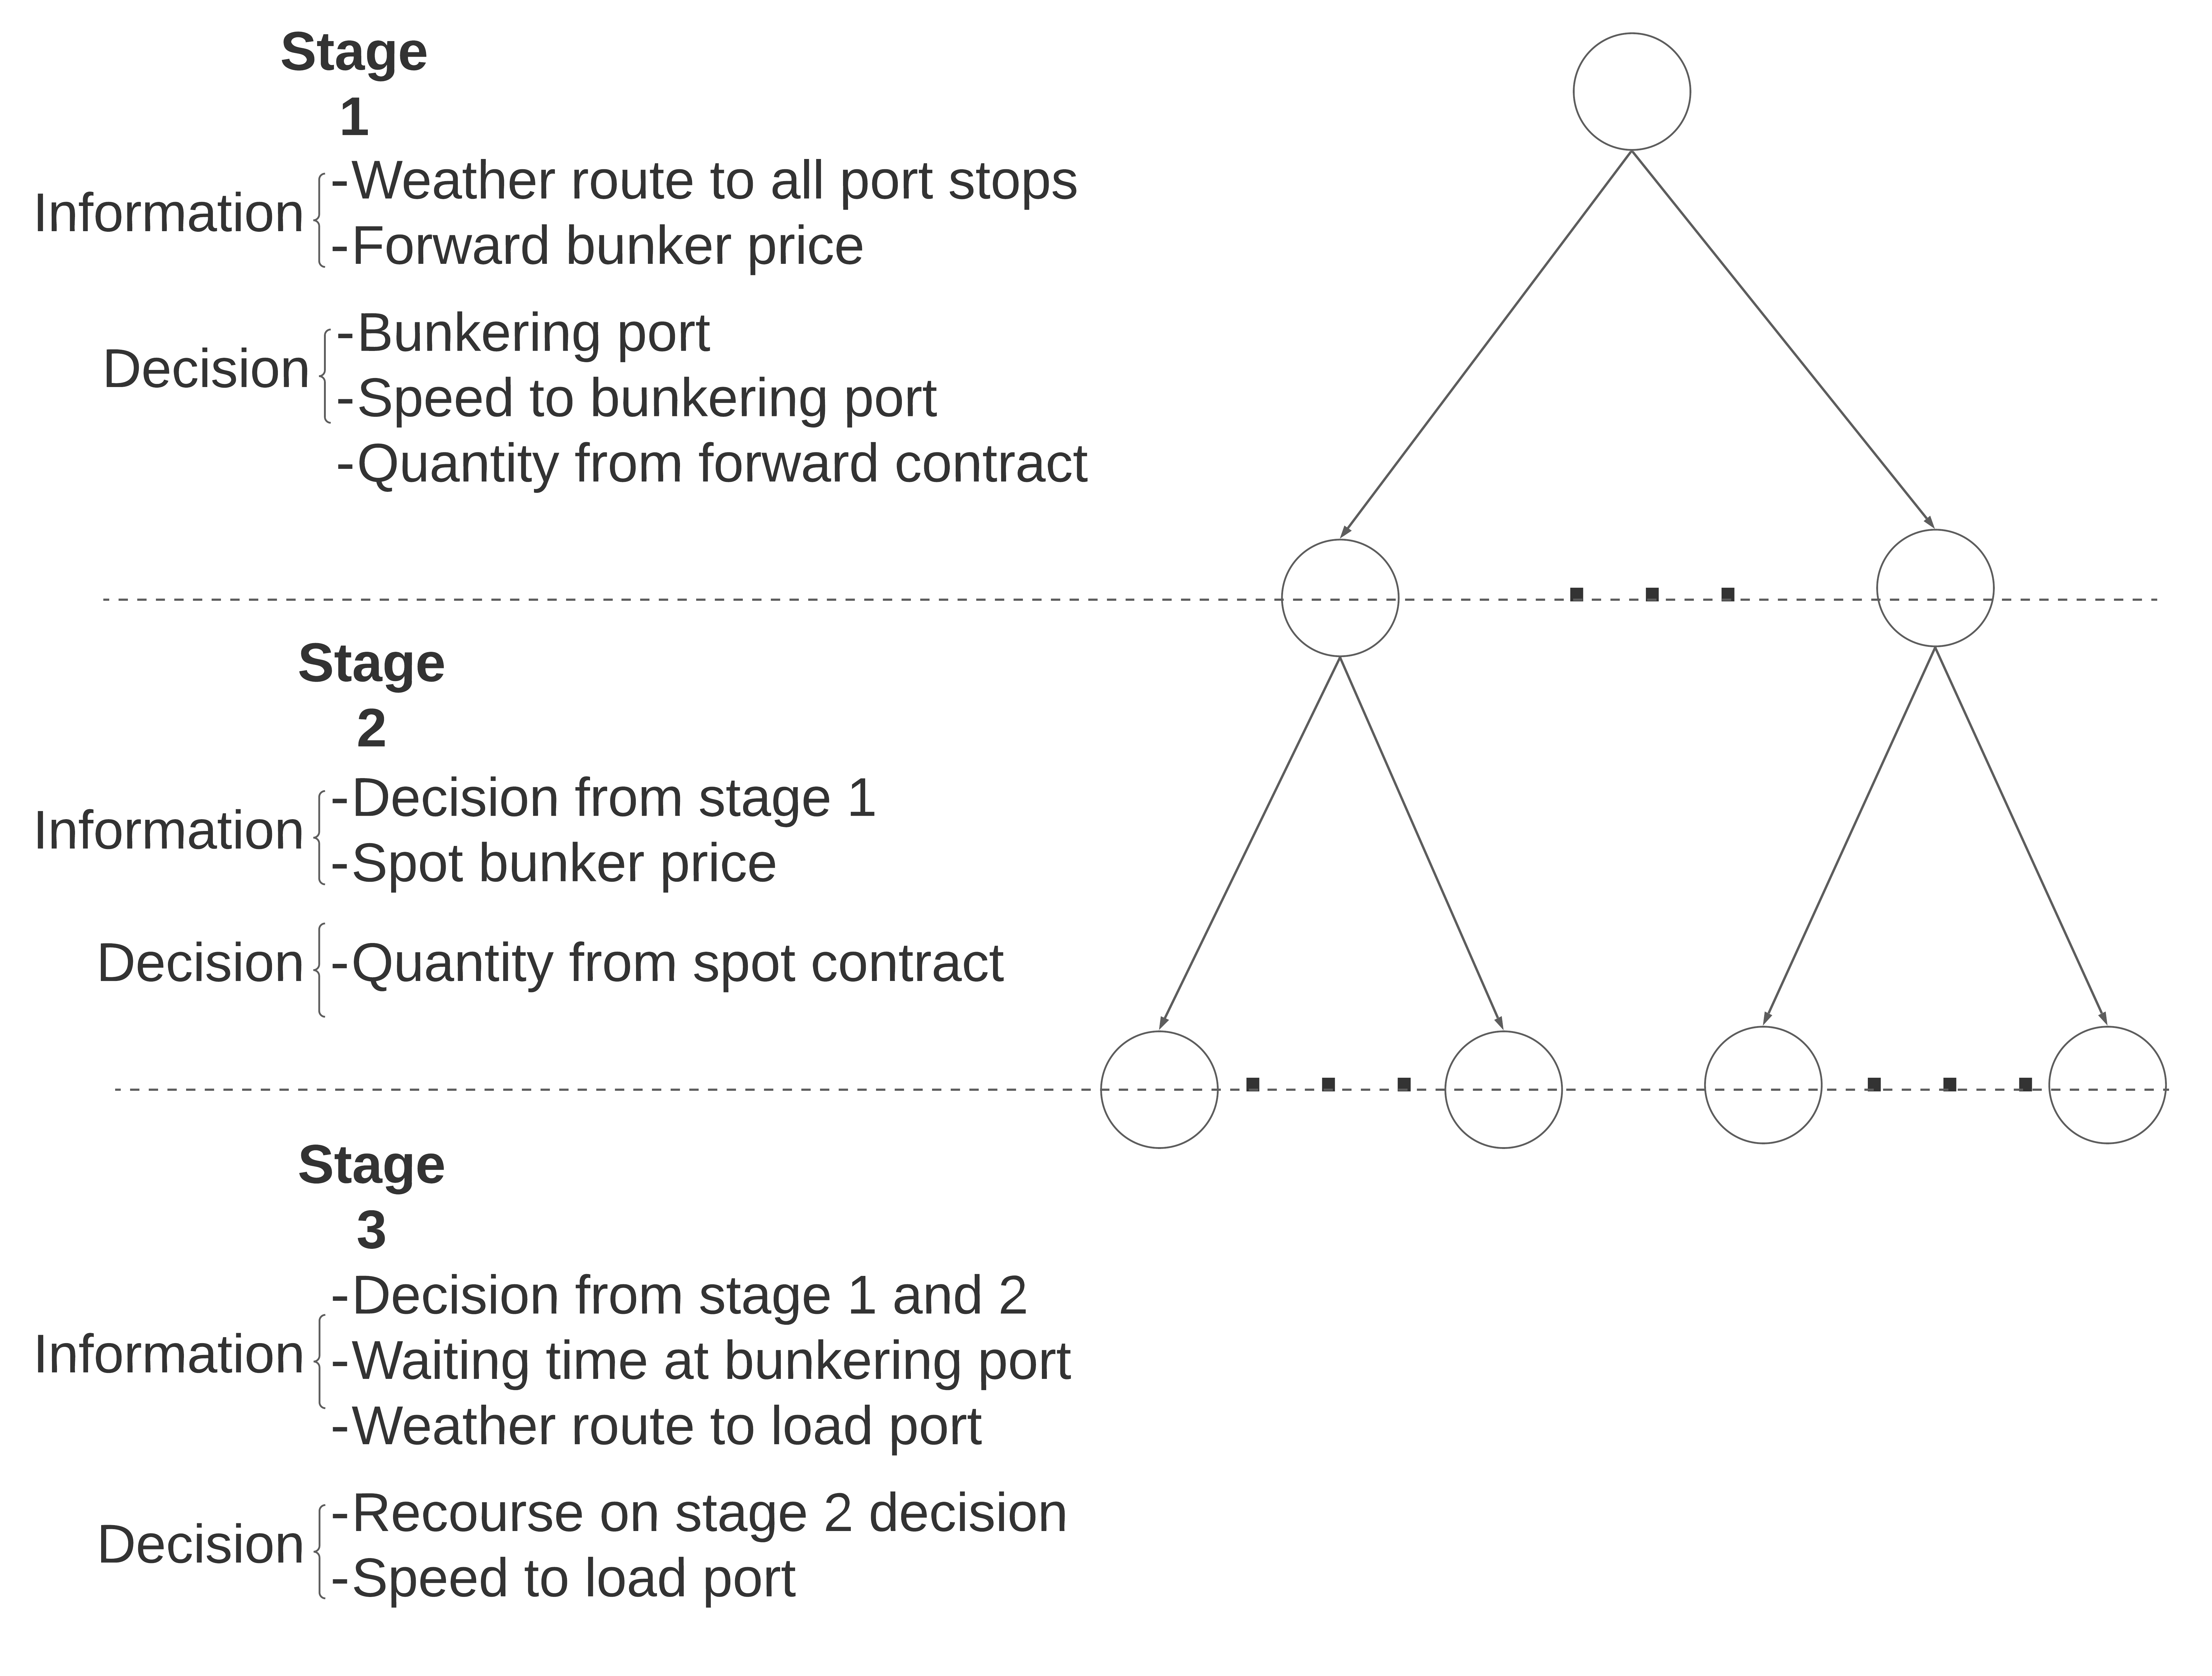
Concept
Scenarios modelled via Copulas Kaut and Wallace (2011)
Waiting times from empirical distributions from Fuentes (2021)
Base problem is a Multi-Stage Mixed Integer Programming model
Weather route profiles created on Isochrones by [James (1957); Hagiwara and Spaans (1987)] + resistance method (summarized by Zis et al (2020). Computation accelerated 10x by GPU.
Long computational times addressed via Progressive Hedging by Rockafellar and Wets (1991)

Slide 11
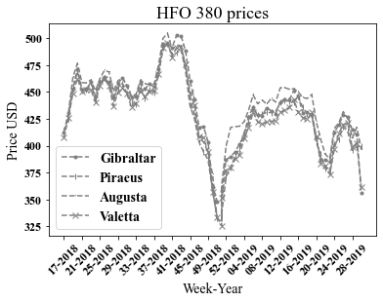
Stochastic input
Waiting time for vessels served at anchor
 | Mean | St.Dev | Median | Min | Max
Syros Island | 1.6 | 1.8 | 0.8 | 0.2 | 8.9
Gibraltar | 1.7 | 1.5 | 1.0 | 0.3 | 7.9
Ceuta | 3.2 | 3.7 | 1.3 | 0.3 | 18.3
Valetta | 4.0 | 4.6 | 1.8 | 0.2 | 23.6
Tanger | 4.7 | 5.2 | 3.0 | 0.5 | 32.9
Limassol | 6.9 | 12.9 | 2.1 | 0.4 | 91.6
Algeciras | 7.4 | 9.8 | 3.3 | 0.4 | 50
Piraeus | 8.3 | 12.6 | 3.8 | 0.2 | 99.0
Augusta | 18.1 | 26.0 | 4.7 | 0.1 | 130.7

Slide 12
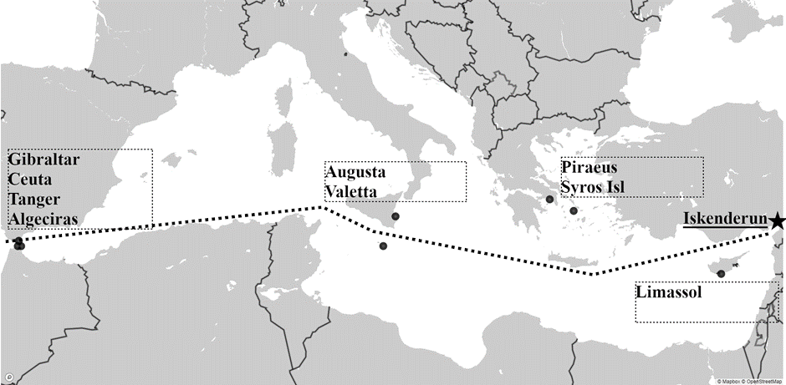

Slide 13
Results and discussion
 | Description | Port (Speed leg 1 /Speed leg 2) | Forward contract bunkers (Stage 1) | Spot contract bunkers (Stage 2) | Additional freight needed/MT | Objective function
Situation 1 | No waiting time | Valetta (6kt/12kt) | 199.9 | 542.1 | - | -407,448
Situation 1 w/o Valetta | No waiting time. Valetta not an option. | Piraeus (4.5kt/12kt) | - | 758.7 | 0.07$ | -406,687
Situation 2 | Stochastic waiting time | Valetta (9.5kt/12kt) | - | 771 | 0.18$ | -402,609
Situation 2 w/o Valetta | Stochastic waiting time. Valetta not an option. | Boston (12/-) | 741 | - | 0.10$ | -405,427
Situation 3 | Strong Med. Weather | Valetta (9.5kt/12kt) | - | 825 | 0.70$ | -400,081

Slide 14
Conclusions
Using stochastic waiting times and weather as values within the bunkering problem suggest to have important effects on the bunkering stop selection. The tradeoff between fuel price and deviation is not enough. (More experiments to conclude)
Lower waiting times ports are more likely to be chosen based on a lower probability of having penalties for not arriving on time.
The former highlights the importance of faster service as a strategy for a bunkering port aiming to be competitive, consistent with Lam et al (2011)
Empirical statistics are important input to operation research models.
Future research should incorporate stochastic weather as forecast distributions into the optimization problem.

Slide 15
THANK YOU!

Slide 16
References
Aydin, N., Lee, H., & Mansouri, S. A. (2017). Speed optimization and bunkering in liner shipping in the presence of uncertain service times and time windows at ports. European Journal of Operational Research, 259(1), 143–154.
Fuentes, G. (2021). Generating bunkering statistics from AIS data: A machine learning approach. Transportation Research Part E: Logistics and Transportation Review, 155, 102495.
Gu, Y., Wallace, S. W., & Wang, X. (2019). Integrated maritime fuel management with stochastic fuel prices and new emission regulations. Journal of the Operational Research Society, 70(5), 707–725.
Hagiwara, H., & Spaans, J. A. (1987). Practical weather routing of sail-assisted motor vessels. The Journal of Navigation, 40(1), 96-119.
James R.W. 1957. Application of wave forecast to marine navigation. Washington: US Navy Hydrographic Office.

Slide 17
References
Kaut, M., & Wallace, S. W. (2011). Shape-based scenario generation using copulas. Computational Management Science, 8(1), 181-199.
Lam, J. S., Chen, D., & Cheng, F. W. 2011. Assesment of the competitiveness of ports as bunkering hubs: Empirical studies on Singapore and Shanghai. Transportation Journal 50 (2), 176-203.
Meng, Q., Wang, S., & Lee, C.-Y. (2015). A tailored branch-and-price approach for a joint tramp ship routing and bunkering problem. Transportation Research Part B: Methodological, 72, 1–19.
Rockafellar, R. T., & Wets, R. J. B. (1991). Scenarios and policy aggregation in optimization under uncertainty. Mathematics of operations research, 16(1), 119-147.
Vilhelmsen, C., Lusby, R., & Larsen, J. (2014). Tramp ship routing and scheduling with integrated bunker optimization. EURO Journal on Transportation and Logistics, 3(2), 143–175.
Zis, T. P., Psaraftis, H. N., & Ding, L. (2020). Ship weather routing: A taxonomy and survey. Ocean Engineering, 213, 107697.

