Slide 1
Taking bunkering into the 21st century: Generating industry statistics from AIS data
Gabriel Fuentes
Leadership 2021

Slide 2
gabrielfuentes.org

Slide 3
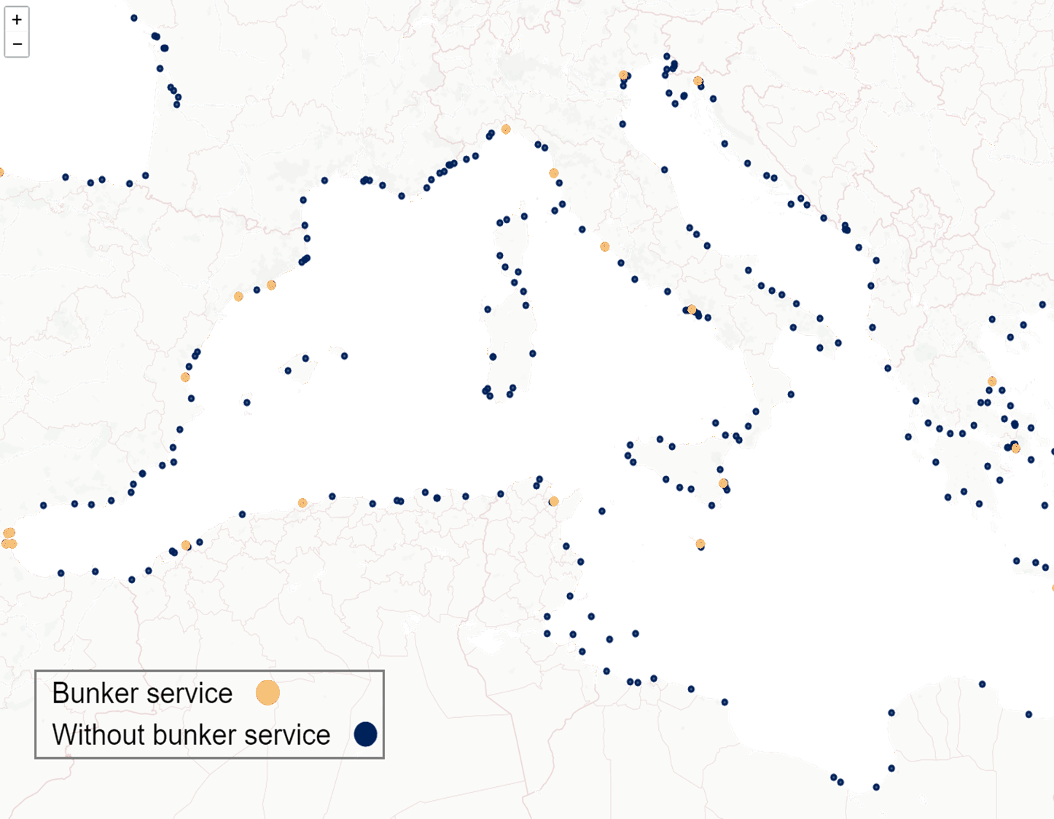
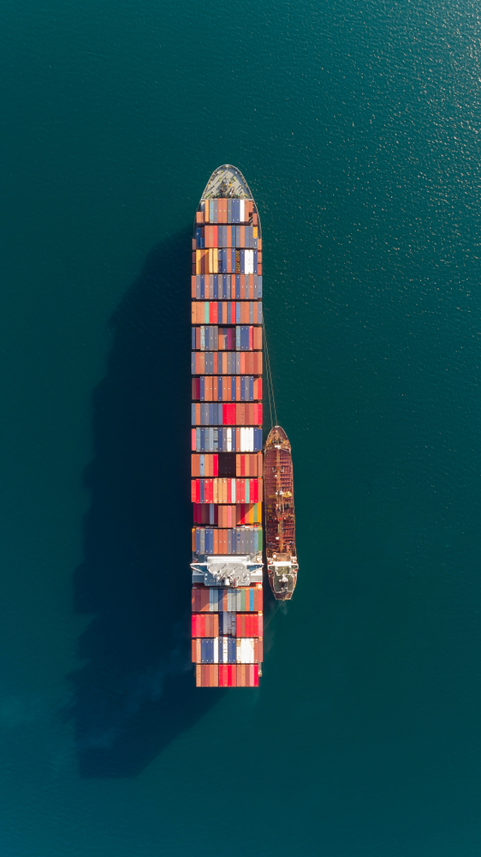

Slide 4
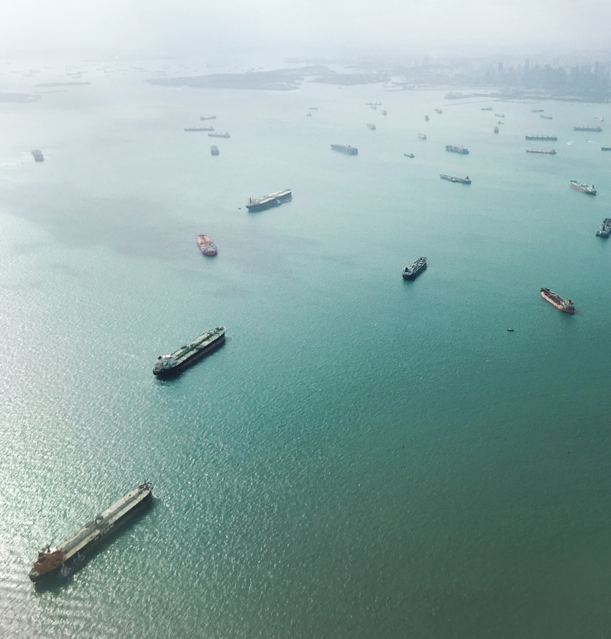
MOTIVATION
Lack of transparency
Beyond traditional price/deviation tradeoff
Limited research on service
Voyage planning becomes more relevant with discussions on carbon levy
Source: straittimes.com

Slide 5
Automatic Identification System
AIS
Required for vessels above 300 GT
Signal collected/transmitted by land and satellite stations
APPLICATION
Collision avoidance
Security surveillance
Research
RESEARCH USE
Vessels emissions
Global trade flows
Fisheries
Underwater noise
Optimal routing
INFORMATION
Vessels position
Particulars

Slide 6
METHODOLOGY
BARGES RECOGNITION
STOPPED VESSEL
BUNKERING
BIG DATA HANDLING
MACHINE LEARNING ALGORITHM
DISTRIBUTED COMPUTING

Slide 7
RESULTS
SERVICES PER PORT
BARGES AGE DIST.
SERVICE TIME DIST.
WAITING TIME DIST.
PORTS RANKING

Slide 8
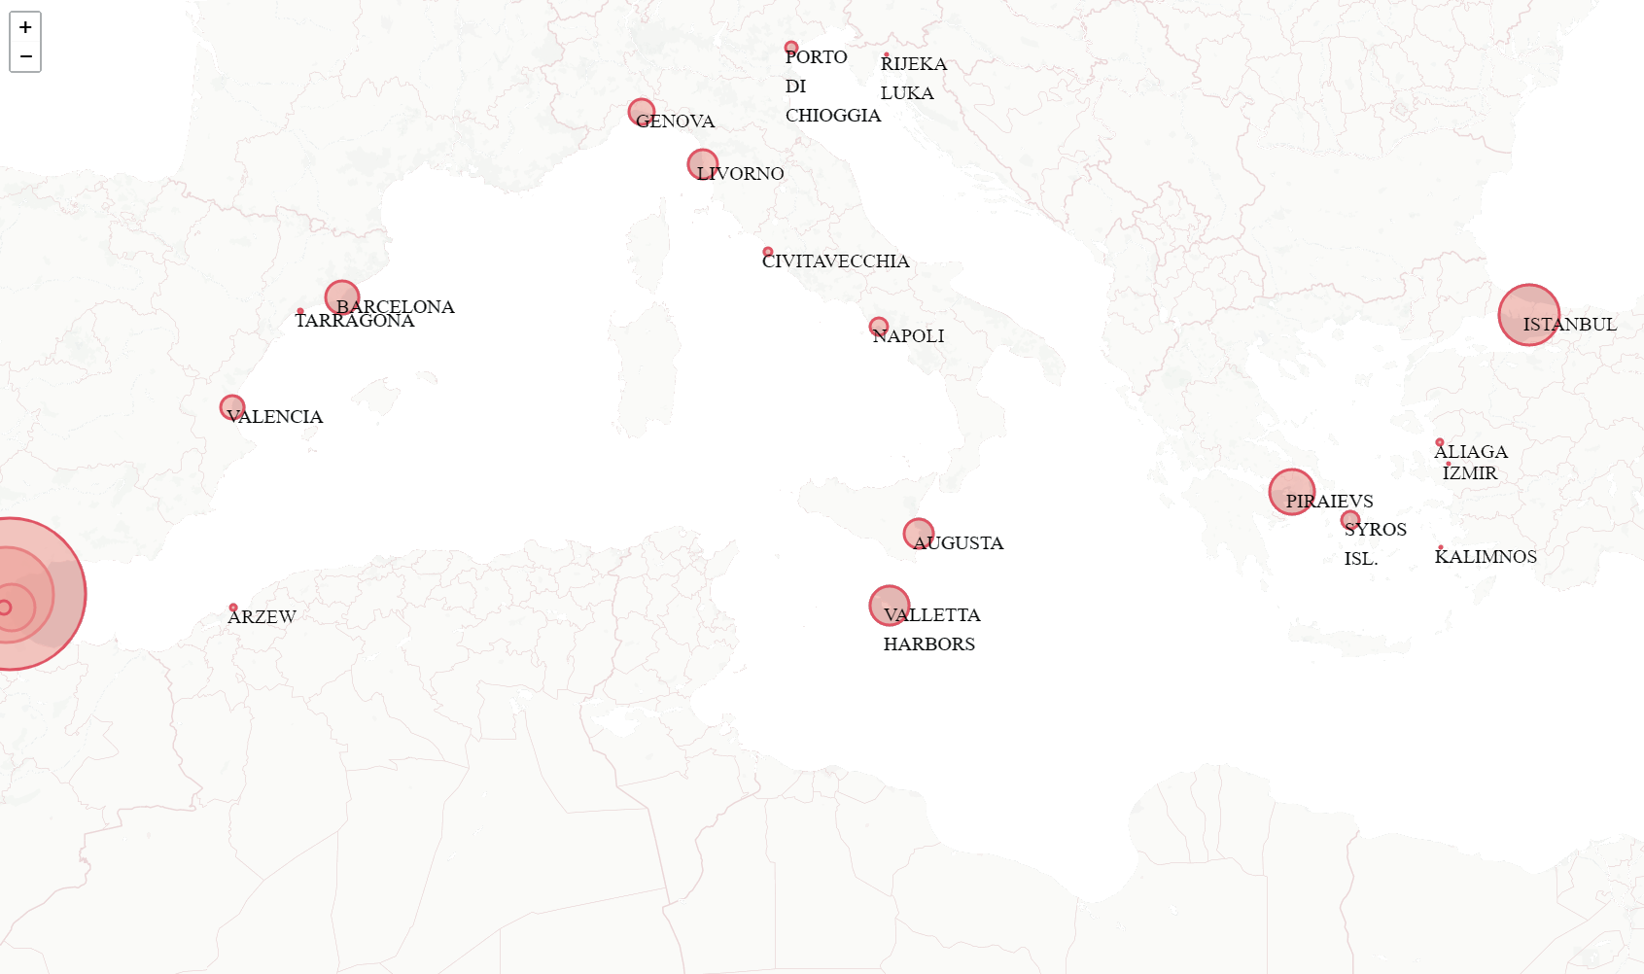
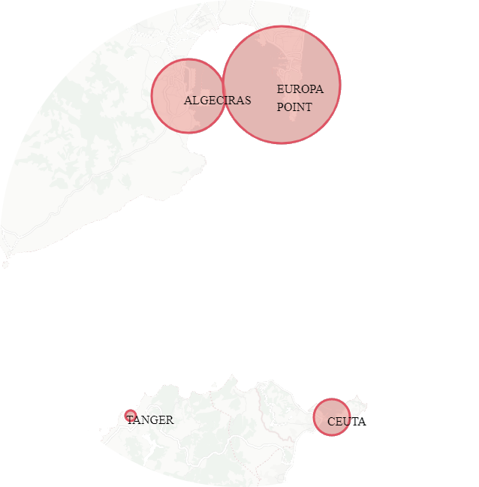
Most visited ports for bunkers:
Gibraltar
Algeciras
Istanbul

Slide 9
PREFERENCES
Bulk Carriers
Port | Bunkering
Gibraltar | 14,809
Algeciras | 2,928
Istanbul | 1,713
Ceuta | 1,177
Piraeus | 257
Limassol | 126
Valletta | 118
Barcelona | 88
Syros Isl. | 74
Mersin | 33
Product Tankers
Port | Bunkering
Gibraltar | 3,610
Algeciras | 2,266
Augusta | 591
Ceuta | 490
Livorno | 274
Piraeus | 272
Barcelona | 268
Limassol | 267
Genova | 127
Napoli | 75
Liner vessels (Containers and Ro-Ro)
Port | Bunkering
Algeciras | 2,443
Valletta | 1,201
Piraeus | 1,110
Barcelona | 591
Valencia | 542
Livorno | 499
Limassol | 314
Genova | 252
Gibraltar | 209
Tanger | 146

Slide 10
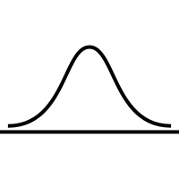
Bunkering statistics
MORE THAN
A MONITORING TOOL
Data driven decision making on commercial ship management
Bunkering management
Voyage optimization

Slide 11
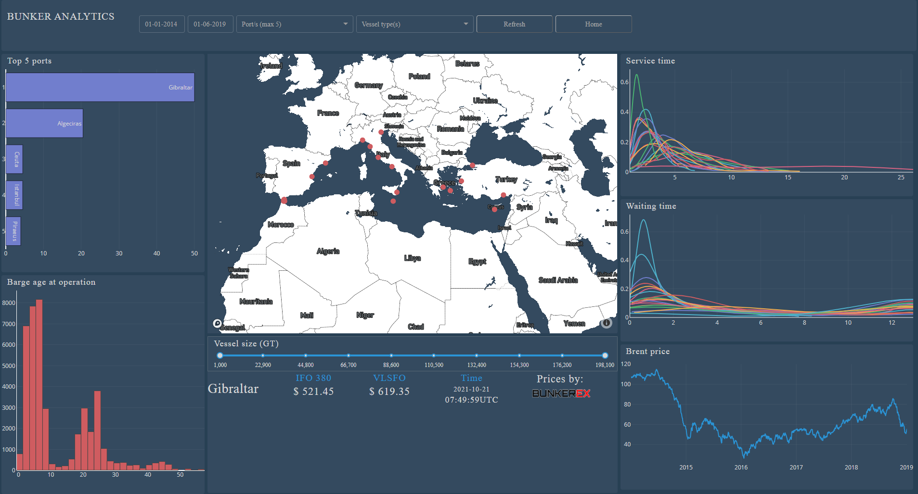
For additional information and to compare ports results, visit:
bunkerstat.gabrielfuentes.org

Slide 12
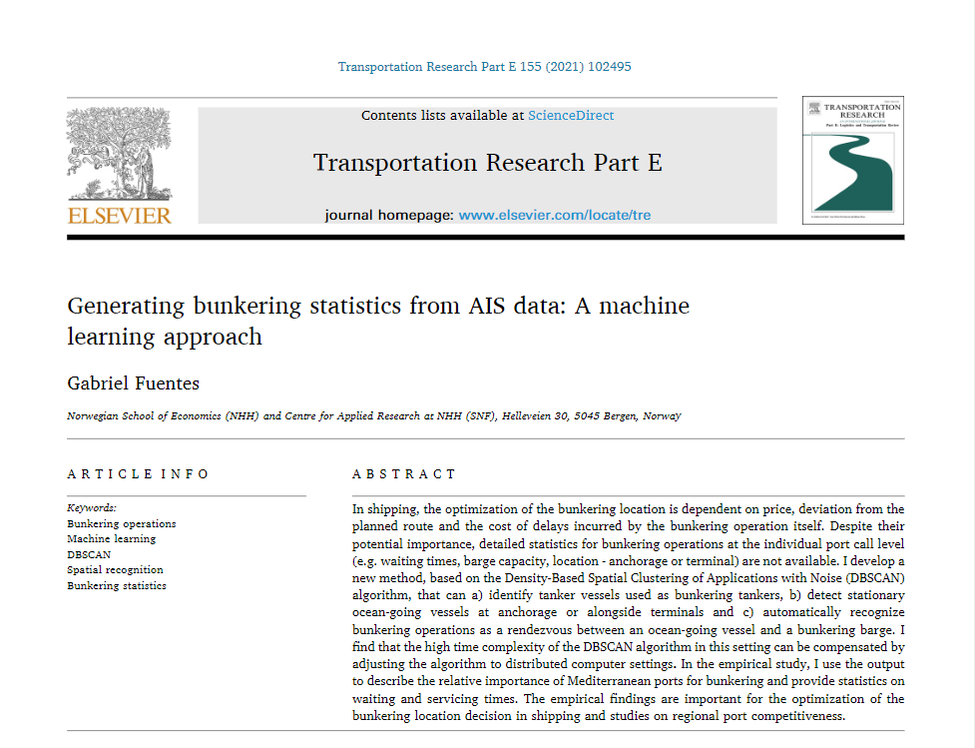

Slide 13
This presentation is based in part on the project “Smart digital contracts and commercial management” (SmartDigital) funded by the Research Council of Norway, grant #280684
THANK YOU

