Slide 1
Generating bunkering statistics from AIS data A machine learning approach
Gabriel Fuentes
IAME 2020

Slide 2
INTRODUCTION
01
METHODOLOGY
02
CONTENT
EMPIRICAL STUDY
03
04
CONCLUSIONS

Slide 3
01
INTRODUCTION

Slide 4
INTRODUCTION
- Bunkering is an unavoidable and important activity for suppliers, ship operators and ports
- Few papers are dedicated to bunkering port competition. Those that have, make use of qualitative techniques on case studies (Lam, J.S.L. et al., 2011; Acosta, M. et al., 2011)
- Bunker location optimization models benefits when using real data (Yao et al., 2012) and when service/waiting times are modelled (Aydin et al., 2017)
- Literature gaps:
Need for a standardized method for collecting micro level bunkering information
Optimization models needs to expand to take into account waiting/service times
Vessel pattern recognition algorithms needs to cater for more granular information
- This paper is about 1) a methodology to collect bunkering statistics from AIS data using the Mediterranean Sea and Marmara Sea information and 2) the validation of the results when compared statistically and against former qualitative studies.
- The methodology is transferable to any setting
4

Slide 5
INTRODUCTION
BUSINESS TOOL
Bunkering information ship operators, ports and suppliers
Not reliable or inexistent information at a port level
LITERATURE
Overcome inconsistencies for detecting stationary vessels
Validate results from qualitative research
PRACTICAL
Create a universal and automatic detection algorithm that recognizes bunkering operations
FUTURE WORK
Service and price interactions on fuels
Bunkering location problem including service time
MOTIVATION
5
5

Slide 6
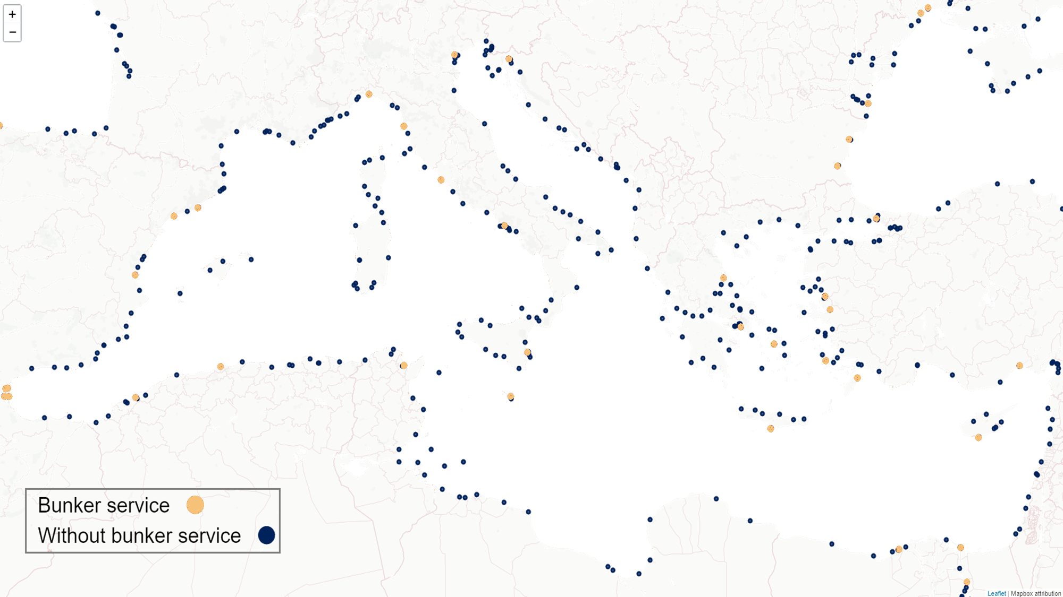
6

Slide 7
INTRODUCTION
Automatic Identification System (AIS)
Required for vessels above 300 GT
Signal collected/transmitted by land and satellite stations
APPLICATION
Collision avoidance
Security surveillance
Research
RESEARCH USE
Vessels emissions
Global trade flows
Fisheries
Underwater noise
Optimal routing
INFORMATION
Vessels position
Particulars
7
7

Slide 8
INTRODUCTION
BUNKER BARGES
Algorithm for classifying bunker barges from overall list of vessels
BUNKER OPS.
Algorithm for the automatic recognition of bunkering operations
STOPPED VESSELS
Detection of vessel at berth or at anchorage
DATABASE
Bunkering statistics for vessels served in the Mediterranean and Marmara sea
CONTRIBUTIONS
8

Slide 9
02
METHODOLOGY

Slide 10
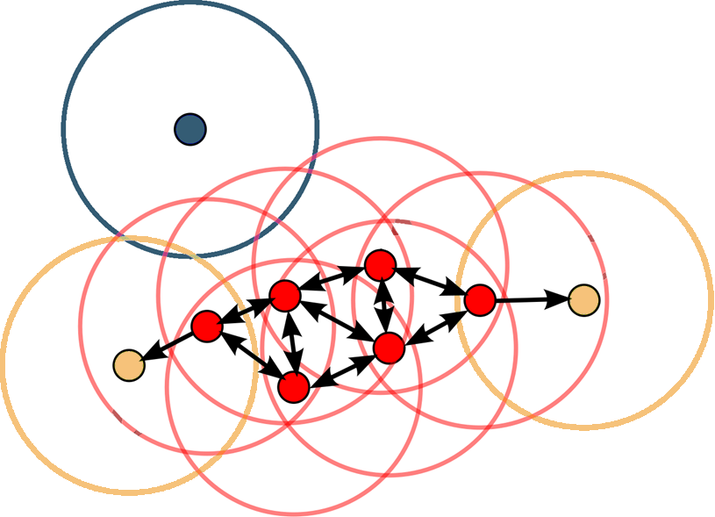
METHODOLOGY
Density-based spatial clustering of applications with noise (DBSCAN)
Clustering algorithm
Falls into the definition of unsupervised machine learning algorithm
n
p
TYPES OF PTS.
p, core points
q, border points
n, noise points
PARAMETERS
minPts, minimum points
$ε$, radius of neighborhood
q
COMPLEXITY
$O\left(n^{2}\right)$ worst case
Enhance to $O\left(nlogn\right)$ by neighborhood query
Source: Wikipedia.
Modified under Creative Commons license
10
10

Slide 11
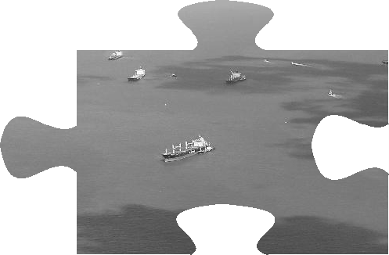
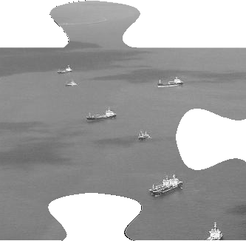
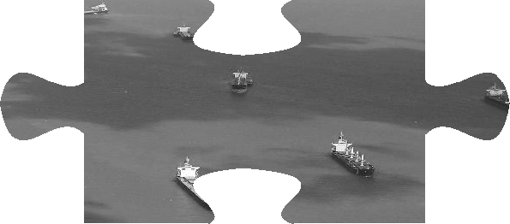
METHODOLOGY
Spatial Analysis
Clustering by DBSCAN
Distribution
Statistics Construction
$O\left(n^{2}\right)$ when matrix calculation is part of algorithm
Parameters based on:
Turning radius
Tidal stream
Meteorological info
Embarrassingly parallel
Asynchronous setting
One vessel per core
Aligned with Message Passing Interface
Raw AIS data transforms automatically to bunkering database
Point in Polygon (PIP) analysis
Vessel to port/barge/ anchorage
11

Slide 12
METHODOLOGY
SECTION 1
BARGES RECOGNITION
PIP on tankers less than 150m LOA. 70% stay in local waters.
Valid with more than 10,000 obs (Approx. 2.5 months)
SECTION 2
STOPPED VESSEL
Less than 3 knots inside local waters
DBSCAN parameters based on tidal streams
SECTION 3
BUNKERING
Points to linestrings.
Buffered linestring with vessels beam
Recognition as bunker barge gets into the vessel polygon
12

Slide 13
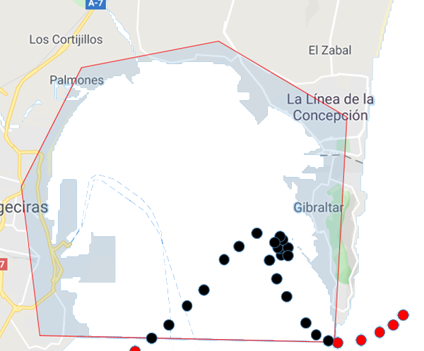
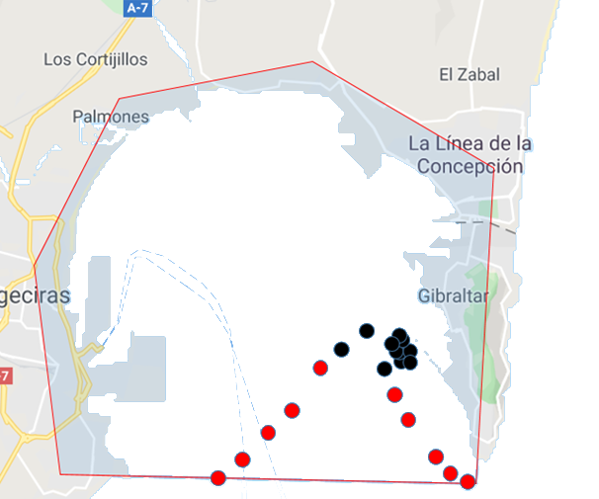
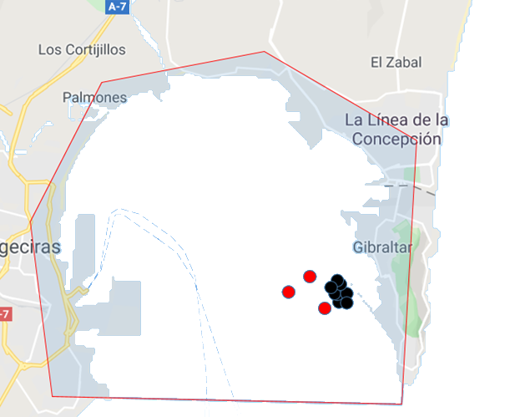
METHODOLOGY
STEP 1
STEP 2
STEP 3
PIP FILTER
Port areas polygons
SPEED FILTER
Less than 3 knots
DBSCAN CLUSTER
Parameters from tidal stream
Section 2
STOPPED VESSEL
13
13

Slide 14
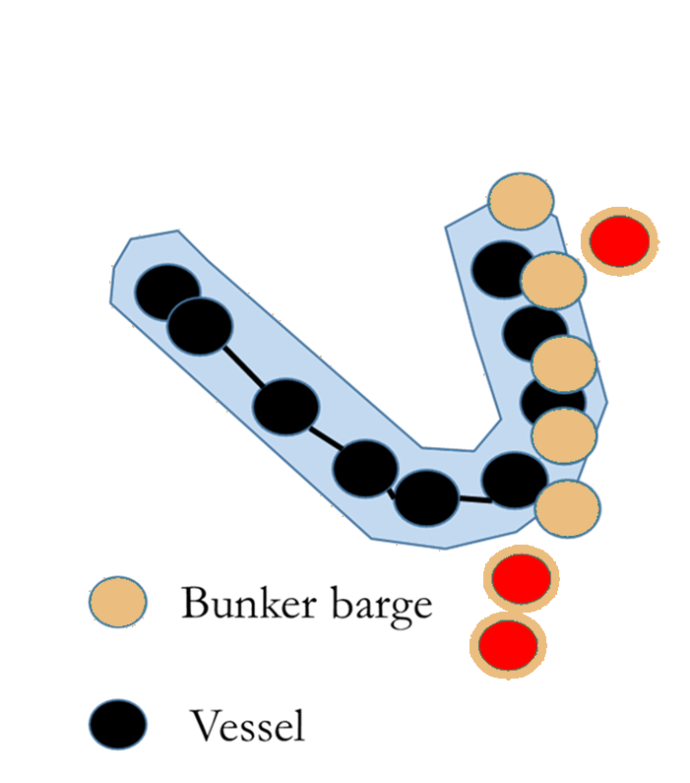
METHODOLOGY
STEP 1
Convert points to linestrings to interpolate sequence
STEP 2
Linestring to polygon with 50 meters buffer
STEP 3
PIP iteration over all barges prospects
STEP 4
Discovery of service barge and collection of data
Section 3
BUNKERING
14
14

Slide 15
03
EMPIRICAL STUDY

Slide 16
EMPIRICAL STUDY
RAW AIS DATA
1.3 billion obs.
80,000 vessels
VESSELS
Quetzal Arrow
Liberty
DBSCAN param.
Min-pts: 3
$ε$-distance:
130m
(0.0012 dec. degrees)
BARGES
Spa bunker 51
Spa bunker 30
San Andres IV

Slide 17
EMPIRICAL STUDY
RAW AIS DATA
1.3 billion obs.
80,000 vessels
VESSELS
Quetzal Arrow
Liberty
DBSCAN param.
Min-pts: 3
$ε$-distance:
130m
(0.0012 dec. degrees)
BARGES
Spa bunker 51
Spa bunker 30
San Andres IV

Slide 18
EMPIRICAL STUDY
RAW AIS DATA
1.3 billion obs.
80,000 vessels
VESSELS
Quetzal Arrow
Liberty
DBSCAN param.
Min-pts: 3
$ε$-distance:
130m
(0.0012 dec. degrees)
BARGES
Spa bunker 51
Spa bunker 30
San Andres IV

Slide 19
EMPIRICAL STUDY
RAW AIS DATA
1.3 billion obs.
80,000 vessels
VESSELS
Quetzal Arrow
Liberty
DBSCAN param.
Min-pts: 3
$ε$-distance:
130m
(0.0012 dec. degrees)
BARGES
Spa bunker 51
Spa bunker 30
San Andres IV

Slide 20
EMPIRICAL STUDY
RAW AIS DATA
1.3 billion obs.
80,000 vessels
VESSELS
Quetzal Arrow
Liberty
DBSCAN param.
Min-pts: 3
$ε$-distance:
130m
(0.0012 dec. degrees)
BARGES
Spa bunker 51
Spa bunker 30
San Andres IV

Slide 21
EMPIRICAL STUDY
RAW AIS DATA
1.3 billion obs.
80,000 vessels
VESSELS
Quetzal Arrow
Liberty
DBSCAN param.
Min-pts: 3
$ε$-distance:
130m
(0.0012 dec. degrees)
BARGES
Spa bunker 51
Spa bunker 30
San Andres IV

Slide 22
EMPIRICAL STUDY
RAW AIS DATA
1.3 billion obs.
80,000 vessels
VESSELS
Quetzal Arrow
Liberty
DBSCAN param.
Min-pts: 3
$ε$-distance:
130m
(0.0012 dec. degrees)
BARGES
Spa bunker 51
Spa bunker 30
San Andres IV

Slide 23
EMPIRICAL STUDY
SERVICES PER PORT
BARGES AGE DIST.
SERVICE TIME DIST.
WAITING TIME DIST.
PORTS RANKING
17

Slide 24
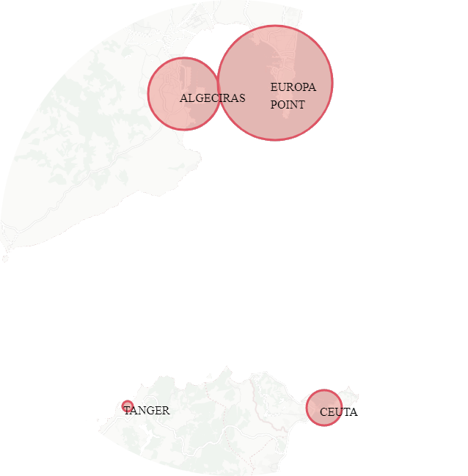
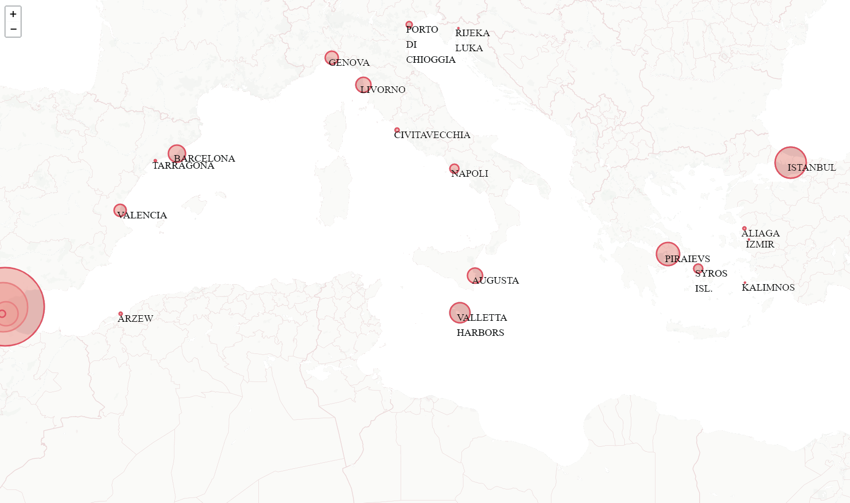
EMPIRICAL STUDY
Most visited ports for bunkers:
Gibraltar
Algeciras
Istanbul
SERVICES PER PORT
18

Slide 25
EMPIRICAL STUDY
Bulk Carriers
Port | Bunkering
Gibraltar | 14,809
Algeciras | 2,928
Istanbul | 1,713
Ceuta | 1,177
Piraeus | 257
Limassol | 126
Valletta | 118
Barcelona | 88
Syros Isl. | 74
Mersin | 33
Product Tankers
Port | Bunkering
Gibraltar | 3,610
Algeciras | 2,266
Augusta | 591
Ceuta | 490
Livorno | 274
Piraeus | 272
Barcelona | 268
Limassol | 267
Genova | 127
Napoli | 75
Liner vessels (Containers and Ro-Ro)
Port | Bunkering
Algeciras | 2,443
Valletta | 1,201
Piraeus | 1,110
Barcelona | 591
Valencia | 542
Livorno | 499
Limassol | 314
Genova | 252
Gibraltar | 209
Tanger | 146
19

Slide 26
EMPIRICAL STUDY
Overall Observations
Year | Observations
2013 | 105
2014 | 6160
2015 | 9408
2016 | 9159
2017 | 9997
2018 | 9931
2019 | 4703*
Gibraltar observations
Year | Gibraltar statistics | Bunk. algorithm | % of total
2013 | 5988 | 101 | 1.7
2014 | 5475 | 2745 | 47.8
2015 | 5571 | 4452 | 80.0
2016 | 5720 | 4261 | 74.4
2017 | 6298 | 5112 | 81.1
2018 | 5829 | 5176 | 88.8
*Observations until June
20

Slide 27
EMPIRICAL STUDY
SERVICE TIME
Variables | (1) Service Time | (2) Service Time | (3) Service Time
Bunker capacity (m³)(/100) | 0.060*** | 0.055*** | 0.056***
Next voyage distance (nm)(/100) | 0.008*** | 0.007*** | 0.007***
Next voyage average speed (knots) | -0.002 | 0.009 | 0.013
Barge age (years) | 0.003 | 0.005 | 0.001
Laden vessel | -0.280*** | -0.302*** | -0.320***
Constant | 5.745*** | 5.758*** | 5.749***
Barges Fixed Effects | No | Yes | Yes
Time Fixed Effects | No | No | Month
Number of observations | 5176 | 5176 | 5176
R² | 0.067 | 0.067 | 0.067
Notes: Robust standard errors. Significance levels are 1% (***), 5% (**) and 10% (*).
21

Slide 28
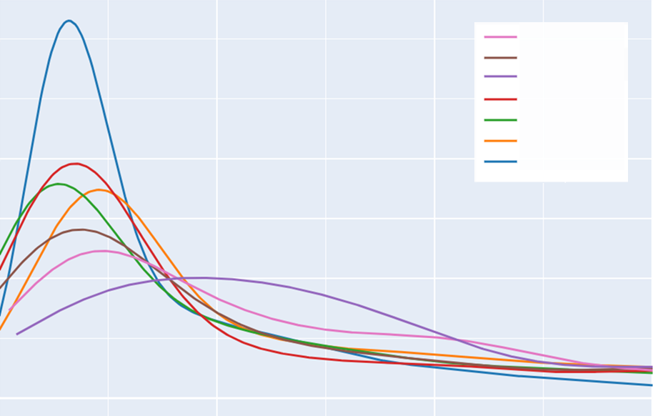
EMPIRICAL STUDY
Punctuality valued as an important bunkering selection factor (Lam, J.S.L., et. al., 2011)
A call for «bunkers only», is expected to have a bunker barge ready as arrived
Waiting time measured from vessel stop initial position and first bunker barge position inside polygon
.6
BARCELONA
VALETTA
TANGER
.5
CEUTA
ISTANBUL
ALGECIRAS
.4
GIBRALTAR
.3
.2
.1
0
Hours
0
1
2
3
4
5
6+
WAITING TIME DIST.
22

Slide 29
CONCLUSIONS
The algorithm is capable of recognizing the irregular shape of vessels at anchor and detecting a large number of operations (Gibraltar comparison)
The reliability of the algorithm depends on the number and quality of sequential AIS observations
DBSCAN proves to be correct when recognizing anchoring patterns and the algorithm proves to work properly for recognizing bunkering operation
Shipping practitioners can benefit from the implementation as the results are customizable to different settings
Future research should extend the bunkering port competition analysis to a global scale.
Waiting and service times will be an important input in the bunkering location optimization problem
23

Slide 30
THANKS

Slide 31
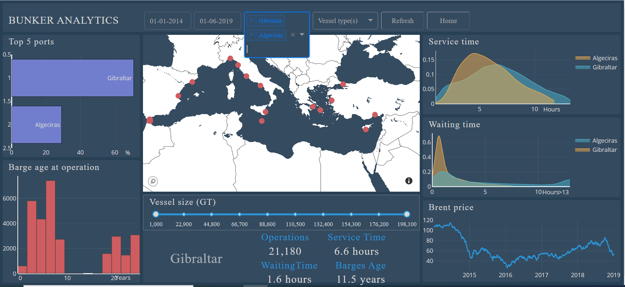
For additional information and to compare ports results from this study, visit:
bunker.gabrielfuentes.org
Repository: github.com/gabrielfuenmar
Additional questions: gabriel.fuentes@snf.no

